Slide 1
Time-base One-time Password
Eddy Kleinjan, Data Access Europe

Slide 2
Authentication

Slide 3

Authentication
Strong Security measures becomes standard
Make sure you know who you are dealing with
Identify the party

Slide 4

UserID and Password
Password should be kept a secret
What if …
  Someone gets access to the password?
  The users uses the same passwords in multiple places?

Slide 5

Use 2 Factor Authentication (2FA)
Something you know, something you have..
Enter User ID, Password and a Dynamically Generated Code

Slide 6








Where to use 2 Factor Authentication?

Slide 7

Time-based One-Time Password (TOTP)
Internet Engineering Task Force standard RFC 6238
TOTP hash-based message authentication code (HMAC)
Basic Implementation
  Takes a secret byte array as input; known by client and server
  Takes the current time in a 30 second windows
  Calculates a 6-digit code

Slide 8
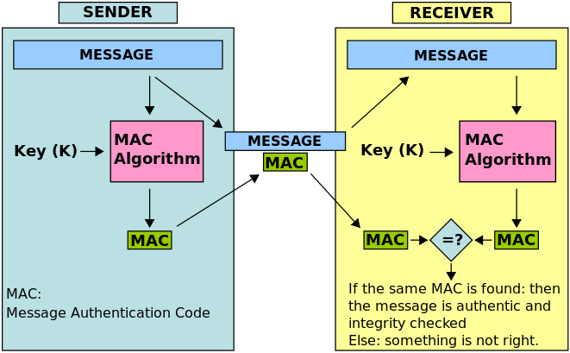
Message Authentication Code

Slide 9
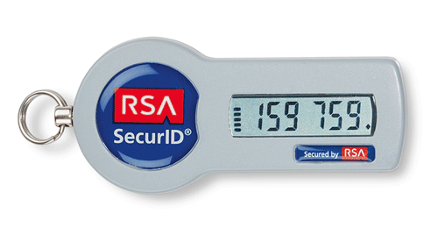
TOTP Generators
SMS Text Message
Token Generator Device
Authenticator Mobile App

Slide 10



Client Side Authenticator Apps
Google Authenticator
Microsoft Authenticator
Authy

Slide 11

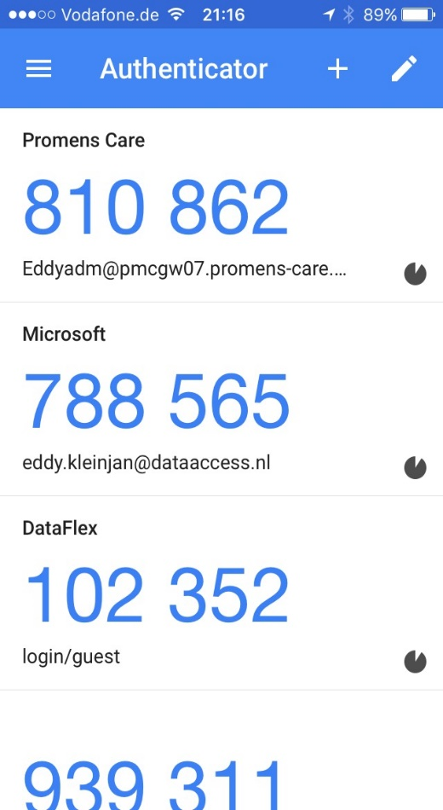
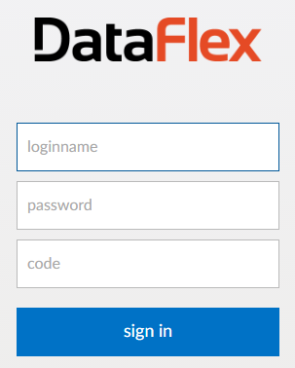
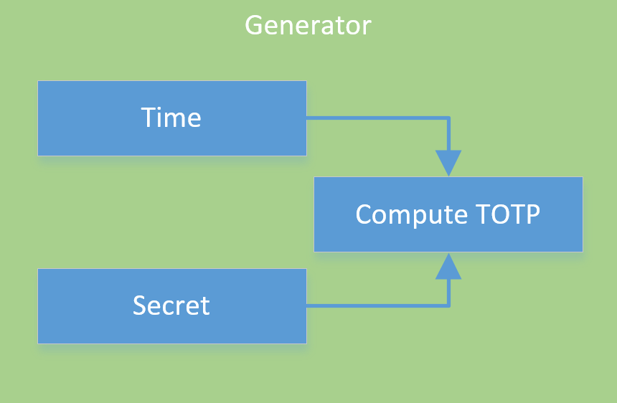
Client Side
102352

Slide 12
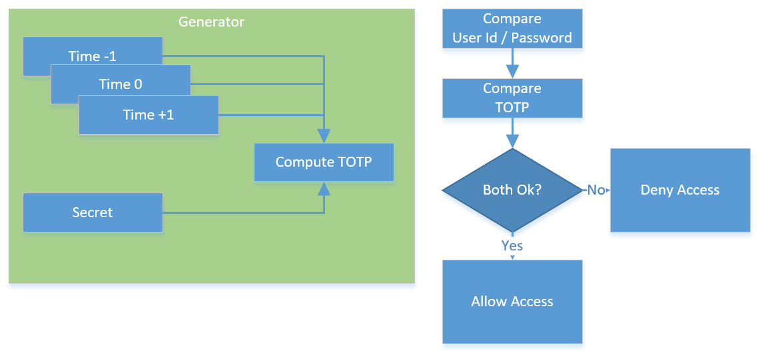
Server Side

Slide 13
Let’s see…

Slide 14
cOneTimePassword.pkg
Implements cOneTimePassword class
Uses DLL for encryption and encoding logic

Slide 15
cOneTimePassword Properties
Property Integer piSecretCodeType otpDecodeNone
Default None; options otpDecodeBase16, otpDecodeBase32 or otpDecodeBase64
Property Integer piDigitCount 6
Default = 6 bit; options 6, 7 or 8
Property Integer piHmacType otpHmacSha1
Default = otpHmacSha1; options otpHmacSha1, otpHmacSha256, otpHmacSha512
Property BigInt piEpoch
Default = 0; options 0 or 1
Property BigInt piTime
Default = 0 (now); otherwise number of seconds since unix time
Property BigInt piStep 30
Default = 30 sec; step size for factor
Property Integer piStepGraceCount 2
Default = 2; Defines maximum number piSteps code may fall outside current time when validating

Slide 16
cOneTimePassword Methods
// To get current TOTP value based on passed secret
Function TOTP String sSecret Returns current TOTP Code
// To test entered Code; may be off by piStepGraceCount * piStep seconds
Function IsValidTimeBasedOneTimePassword ;
String sSecret
String sCode
Returns True/False

Slide 17
Issue TOTP Details to User using URI
Define the length of the code; 6, 7 or 8 digits
Define the encryption algorithm: SHA-1; SHA-256; SHA-512
Define the time-window in seconds; default 30 seconds
Share Secret Byte; base32 encoded
URI:
otpauth://totp/DFAUTH:guest@dataflex?secret=7K7I7JYE3QTAUZXRB3ZRK32J5RLJU4MSUZOQMBSXEUXQRCO5C5SV====&issuer=DataFlex&algorithm=SHA256&digits=6&period=30

Slide 18
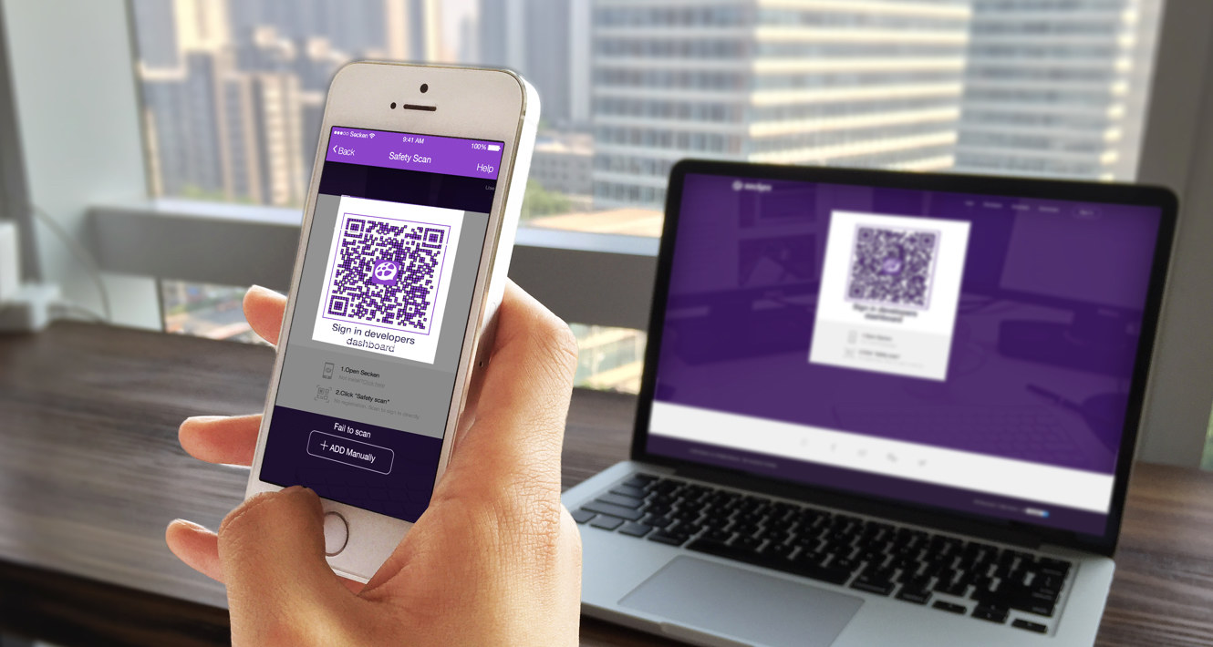
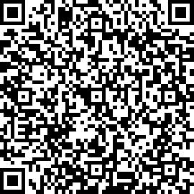
Issue TOTP Details to User using URI
7K7I7JYE3QTAUZXRB3ZRK32J5RLJU4MSUZOQMBSXEUXQRCO5C5SV====
Generate QR Code for Ease of use
Scan using Authenticator App

Slide 19

Implement procedures
How to Issue Secrets?
Re-Issue Secrets?
Password Reset?

Slide 20
Questions?

Slide 21
Thank you!

