Slide 1
CUSTOM CONTROLS
Presented by Henri Reterink

Slide 2
Why a custom control?
Expand the WebApp framework with functionality that is not provided by the default toolkit
Generic reusable controls
Graphs / Charts
Scheduler
HTML Editor
More specific feature desires
Procedural questionnaire
Dynamically generated dashboard

Slide 3
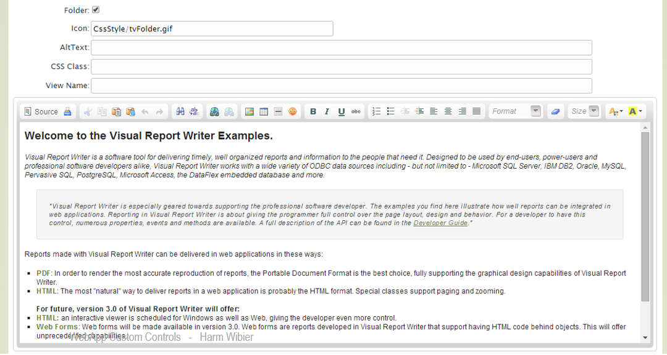
HTML Editor control example
cHtmlEditor

Slide 4
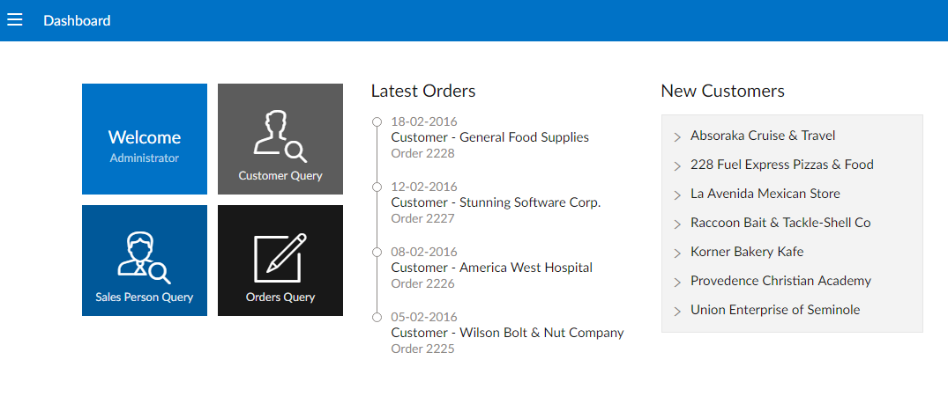
A Dynamic Dashboard

Slide 5
What is a custom control
DataFlex component that you can add to a view. Usually something visible
DataFlex
JS
JavaScript
Server side portion
A class
Provides API’s for the application to work with
Client side portion
Implements the wanted feature using the framework API’s
Usually renders something on screen
A pseudo “Class” in javascript

Slide 6
Knowledge required
DataFlex classes and subclassing
JavaScript
HTML and DOM Manipulation
WebApp Framework basics
To some extent...
CSS
Ajax

Slide 7
Case: “Build a scheduler control for the DF Web Framework”

Slide 8
Determining the initial set of requirements
CRUD: Create, Read, Update and Delete events
Easy to use, intuitive
Relatively easy to implement in a variety of applications
Accept event data in a fixed format, but from multiple sources
Flexible and customizable

Slide 9
Build or wrap?
Building it ourselves
Wrapping an existing control / library
Pros:
Full control over usage, look, etc
Possibly more DF “native”
Pros
No reïnventing the wheel
Can save a lot of time
Cons
Having to build every single piece ourselves
Cons
Limited control over usage, look, etc
No API Standards
Possible dependancy on other libraries like jQuery

Slide 10
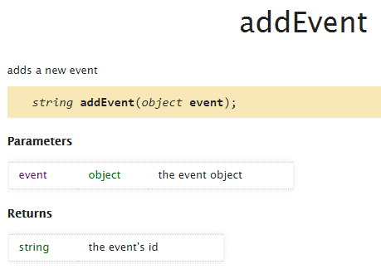
Winner: DHTMLx Scheduler
Clean, simple but effective look
User friendly interaction with drag-and-drop and in-calendar dialogs
Very flexible
Very customizable
Well documented(!)
Cons:
License for commercial products

Slide 11
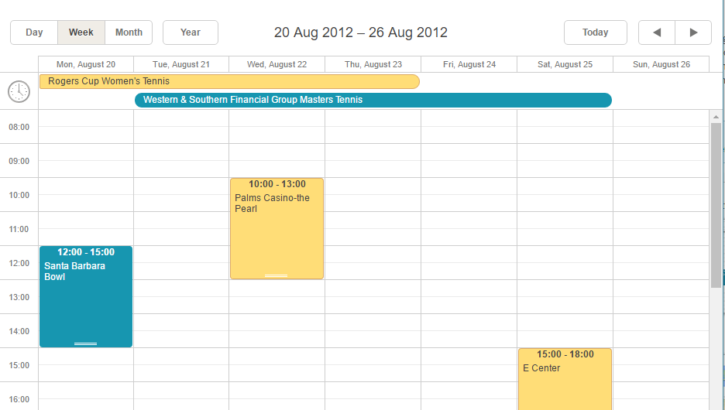
Winner: DHTMLx Scheduler

Slide 12
Setting up…

Slide 13
At the DataFlex side…
Create a package for our Class
Extend from a WebApp Framework base class, common ones are
cWebObject
cWebBaseUIObject
cWebBaseControl

Slide 14
Define our JS class name
This will have to match with the name defined in the JS file later
Class cWebDhxScheduler is a cWebBaseControl
Procedure Construct_Object
Forward Send Construct_Object
Set psJSClass to "dfhx.WebDhxScheduler"
End_Procedure
End_Class

Slide 15
Configure super classes
Procedure Construct_Object
Forward Send Construct_Object
// Configure super classes
Set pbFillHeight to True
Set piColumnSpan to 0
Set pbShowLabel to False
Set psJSClass to "dfhx.WebDhxScheduler"
End_Procedure

Slide 16
At the JavaScript side…
Create a .JS file
Create a “namespace” object (optional)
Create our “constructor” function
Configure superclasses
// Create namespace object (dfhx = dataflex dhtmlx)
if(!dfhx){
var dfhx = {};
}
dfhx.WebDhxScheduler = function WebDhxScheduler(sName, oPrnt){
// Configure superclasses
dfhx.WebDhxScheduler.base.constructor.apply(this, arguments);
};
JS

Slide 17
Define our class (matches with class defined in DF)
Extend from a base class, common ones:
df.WebObject
df.WebBaseUIObject
df.WebBaseControl
// Create namespace object (dfhx = dataflex dhtmlx)
if(!dfhx){
var dfhx = {};
}
dfhx.WebDhxScheduler = function WebDhxScheduler(sName, oPrnt){
// Configure superclasses
dfhx.WebDhxScheduler.base.constructor.apply(this, arguments);
};
df.defineClass("dfhx.WebDhxScheduler", "df.WebBaseControl", {
// Control functions and logic will go here
});
JS

Slide 18
WebProperties
Can be used to store things like data, status information and settings for the control
Property value is shared and maintained between Client and Server
Engine generates default Get & Set functions in JS if no custom ones are defined
Called when executing WebGet and WebSet functions in DF, and at several other times
Implement a custom setter method as set_psPropertyName
Implement a custom getter method as get_psPropertyName

Slide 19
WebProperties
DataFlex definition
// Defines whether events can be dragged or not
{WebProperty = True}
Property Boolean pbAllowEventDrag
JavaScript definition
dfhx.WebDhxScheduler = function WebDhxScheduler(sName, oPrnt){
dfhx.WebDhxScheduler.base.constructor.apply(this, arguments);
// Define our property
this.prop(df.tBool, "pbAllowEventDrag", true);
};
JS
Our custom setter
set_pbAllowEventDrag : function(bVal){
if(this._eControl){
// DhxNoResize true tells the dHTMLx scheduler to not allow event dragging
// Calling "Set pbAllowEventDrag false" from DF would set DhxNoResize to true, and block event dragging
df.dom.toggleClass(this._eControl, "DhxNoResize", !bVal);
}
},
JS

Slide 20
Displaying your control on screen OpenHtml, CloseHtml and AfterRender

Slide 21
Rendering the control
UI Objects render themselves on the client by generating HTML
Recursive functions openHtml, closeHtml and afterRender are triggered
openHtml and closeHtml are used to insert HTML elements into the document
afterRender is called afterwards to perform DOM Manipulation
Creation
Object definitions are sent to the client by the server
Render
render()
openHtml(aHtml)
closeHtml(aHtml)
afterRender()

Slide 22
OpenHtml, CloseHtml
Our openHtml and closeHtml functions
Create a container for our scheduler to fit in using HTML elements
On initialization we’ll tell the dHTMLx Scheduler to render itself inside this container
// Creates the HTML elements to "draw" for our control
openHtml : function(aHtml){
// "Forward send"
dfhx.WebDhxScheduler.base.openHtml.call(this, aHtml);
aHtml.push('<div class="dhx_cal_container" style="width:100%; height:100%;">');
aHtml.push(' <div class="dhx_cal_navline">');
aHtml.push(' <div class="dhx_cal_date"></div>');
aHtml.push(' </div>');
aHtml.push(' <div class="dhx_cal_header"></div>');
aHtml.push(' <div class="dhx_cal_data"></div>');
aHtml.push('</div>');
},
// Creates the HTML elements to "draw" for our control
// Called after all openHtml functions are done
closeHtml : function(aHtml){
// Just "Forward Send" for now
dfhx.WebDhxScheduler.base.closeHtml.call(this, aHtml);
},
JS

Slide 23
AfterRender
Our afterRender function
Html container has been created and rendered on screen
Set some properties and tell the dHTMLx scheduler to initialize inside our container
// Called after the control has been rendered on screen
afterRender : function(){
// Find our container, mark it as our control root
this._eControl = df.dom.query(this._eElem, ".dhx_cal_container");
// Forward send
dfhx.WebDhxScheduler.base.afterRender.apply(this, arguments);
// This function sets dHtmlx Scheduler properties and initializes it in our container
this.initScheduler();
// Can only call this setter after control is rendered
this.set_pbAllowEventDrag(this.pbAllowEventDrag);
},
JS

Slide 24
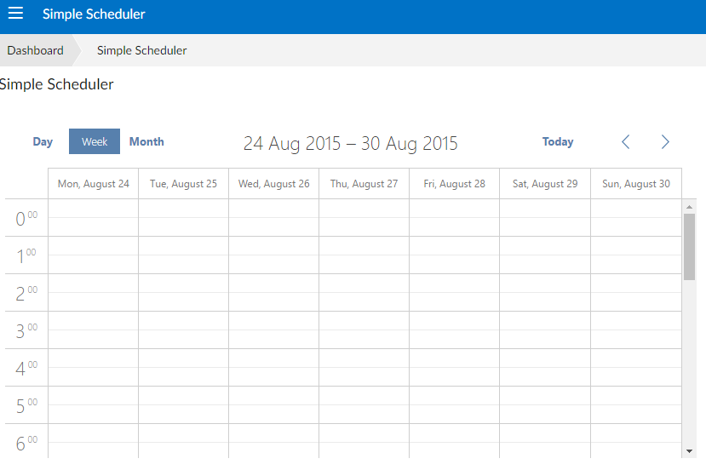

Slide 25
Making it do stuff… ServerActions and ClientActions

Slide 26
Server Actions
Basically just DF procedures / functions
Can be called by the JS Client by using:
this.serverAction("MethodName", aParams);
Optionally provide a return value
Must be made available to the client by using
WebPublishProcedure ProcedureName
WebPublishFunction FunctionName

Slide 27
ServerAction to load events
Our ServerAction, a DataFlex procedure
Procedure LoadEvents String sMode String sStartDate String sEndDate
tWebValueTree tVT
String[] aParams
Date dStart dEnd
// Event Array to be filled and sent to the client
tWebDhxEvent[] aEvents
Move (ConvertFromClient(typeDate, sStartDate)) to dStart
Move (ConvertFromClient(typeDate, sEndDate)) to dEnd
// Event hook, allows augmentation for application specific logic. Fill event array
Send OnLoadEvents (&aEvents) sMode dStart dEnd
// Serialize Event array to a WebValueTree
ValueTreeSerializeParameter aEvents to tVT
// Call clientaction to process data
Move sMode to aParams[0]
Move sStartDate to aParams[1]
Move sEndDate to aParams[2]
Send ClientAction "handleEvents" aParams tVT
End_Procedure

Slide 28
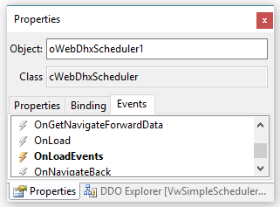
Event “hook”
Event “hook” for our ServerAction
Allows you to define the main universal logic yourself
Developers can place application specific logic inside the event hook
Shows up in Object Properties panel!
// Called by LoadEvents
{ MethodType=Event }
Procedure OnLoadEvents tWebDhxEvent[] ByRef aEvents String sMode Date dStart Date dEnd
// Augment this procedure with your own business logic to load events
End_Procedure

Slide 29
Exposing and calling our procedure
Exposing our procedure to the client
Procedure End_Construct_Object
Forward Send End_Construct_Object
// Allows our "ServerAction" to be called from the JS Client
WebPublishProcedure LoadEvents
End_Procedure
Calling our procedure from the client
JS
loadData : function(sMode, dStart, dEnd){
// Calls the "LoadEvents" procedure on the server, with given parameters
this.serverAction("LoadEvents", [ sMode, this.toSvrDate(dStart), this.toSvrDate(dEnd) ], null, function(){
// Logic to be executed if the function / procedure has returned something
});
},

Slide 30
Client Actions
Functions in JavaScript
Can be called by the DF Server by using
Send ClientAction "methodName" aParams
Send ClientAction "methodName" aParams tWebValueTree
tWebValueTree is data serialized to a format the client and server can both read and deserialize
Work asynchronously
Parameters are provided as Strings

Slide 31
Calling our ClientAction
Calling our ClientAction “handleEvents” from the server
// Serialize data
ValueTreeSerializeParameter aEvents to tVT
// Call clientaction to process data
Move sMode to aParams[0]
Move sStartDate to aParams[1]
Move sEndDate to aParams[2]
Send ClientAction "handleEvents" aParams tVT
End_Procedure

Slide 32
Our ClientAction
Our ClientAction, a function in JavaScript
// (De)serializers for data sent by and to the server
deserializeVT : df.sys.vt.generateDeserializer([ dfhx.tWebDhxEvent ]),
serializeVT : df.sys.vt.generateSerializer([ dfhx.tWebDhxEvent ]),
// ClientAction called by the server
handleEvents : function(sMode, sStart, sEnd){
// Deserialize recieved data
var i, aEvents = this.deserializeVT(this._tActionData);
if(this._oScheduler){
this._oScheduler.clearAll();
// Convert dates
for(i = 0; i < aEvents.length; i++){
aEvents[i].start_date = df.sys.data.stringToDate(aEvents[i].start_date, "yyyy/mm/ddThh:mm:ss.fff");
aEvents[i].end_date = df.sys.data.stringToDate(aEvents[i].end_date, "yyyy/mm/ddThh:mm:ss.fff");
}
// Pass to scheduler control
this._oScheduler.parse(aEvents, "json");
}
},
JS

Slide 33
Using your control in multiple projects

Slide 34
How to import your control
Develop your control in a separate, standalone workspace
In your application workspace...
add the control workspace as a library
copy the control .JS file to an AppHtml subfolder
copy any other required files used by the control as well if needed
add a reference to the required .JS files in your Index.html
You can even add it to the class pallette for convenience!
<!-- DHTMLX Scheduler -->
<script src="dhtmlx/dhtmlxscheduler.js" type="text/javascript"></script>
<script src="dhtmlx/ext/dhtmlxscheduler_limit.js"></script>
<script src="dhtmlx/ext/dhtmlxscheduler_units.js"></script>
<script src="dhtmlx/ext/dhtmlxscheduler_timeline.js"></script>
<script src="dhtmlx/ext/dhtmlxscheduler_multiselect.js"></script>
<script src="dhtmlx/ext/dhtmlxscheduler_tooltip.js"></script>
<!-- <link rel="stylesheet" href="dhtmlx/dhtmlxscheduler.css" type="text/css"> -->
<link rel="stylesheet" href="dhtmlx/dhtmlxscheduler_flat.css" type="text/css">
<!-- DataFlex Custom Controls (do not remove this line, used for automatic insertion) -->
<script src="Custom/WebDhxScheduler.js"></script>

Slide 35
Demo…

Slide 36
There’s much more to learn!
Some things we haven’t talked about include...
Events
Private client properties
Synchronized WebProperties
Serializing and deserializing data
Etc.
Want some examples? The default WebApp classes are right there!
Take a look in the AppHtml/DfEngine of your webapp
Study controls like the WebButton, WebForm, etc.

Slide 37
Thank you for your attention. Are their any questions?

